Slide 1
Tea-time story
Sharmili Srinivasan

Slide 2
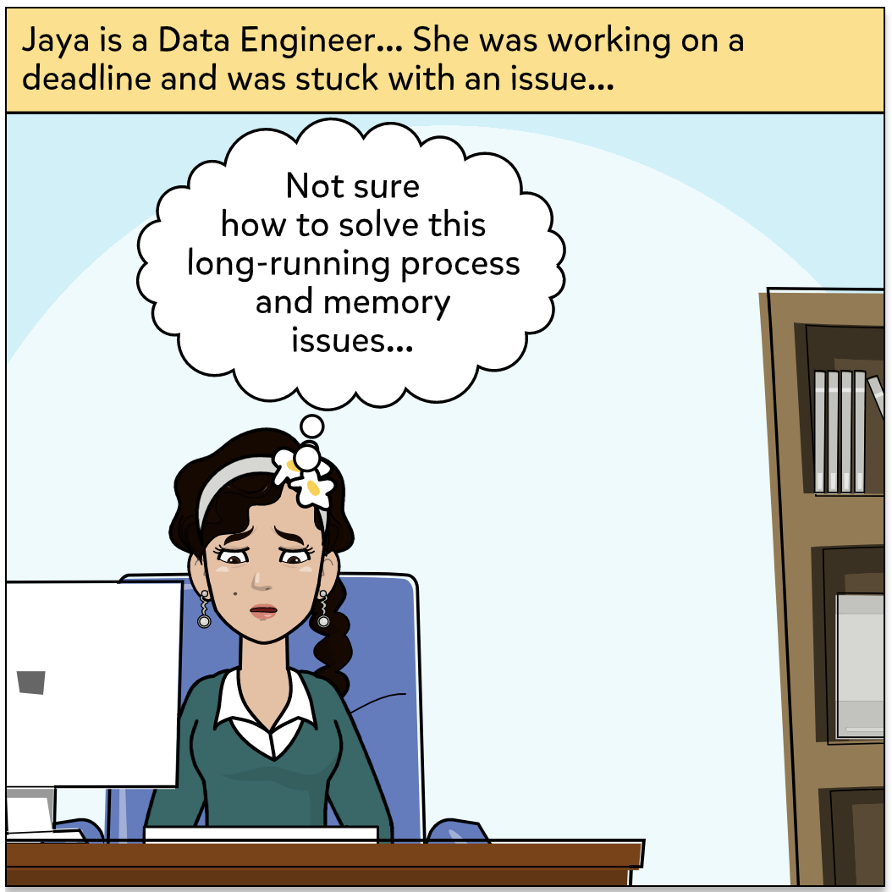

Slide 3
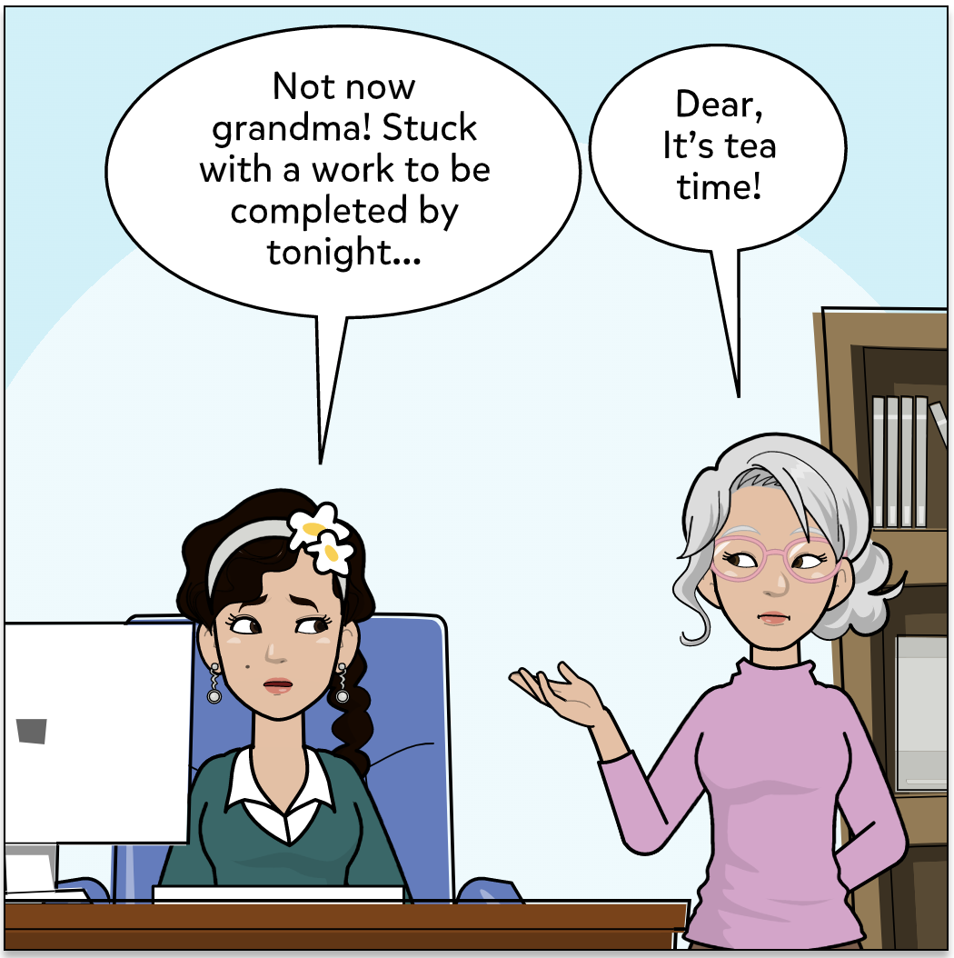

Slide 4
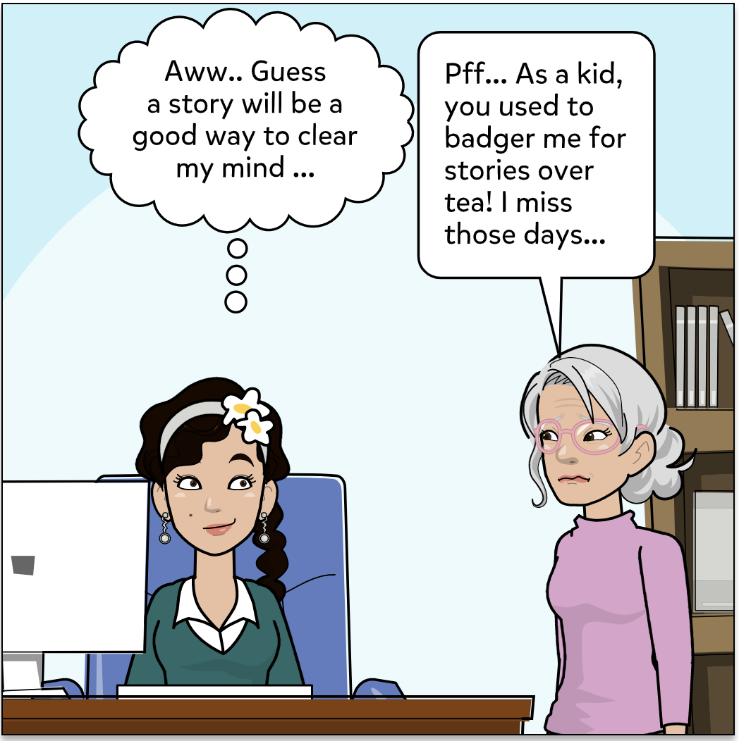

Slide 5
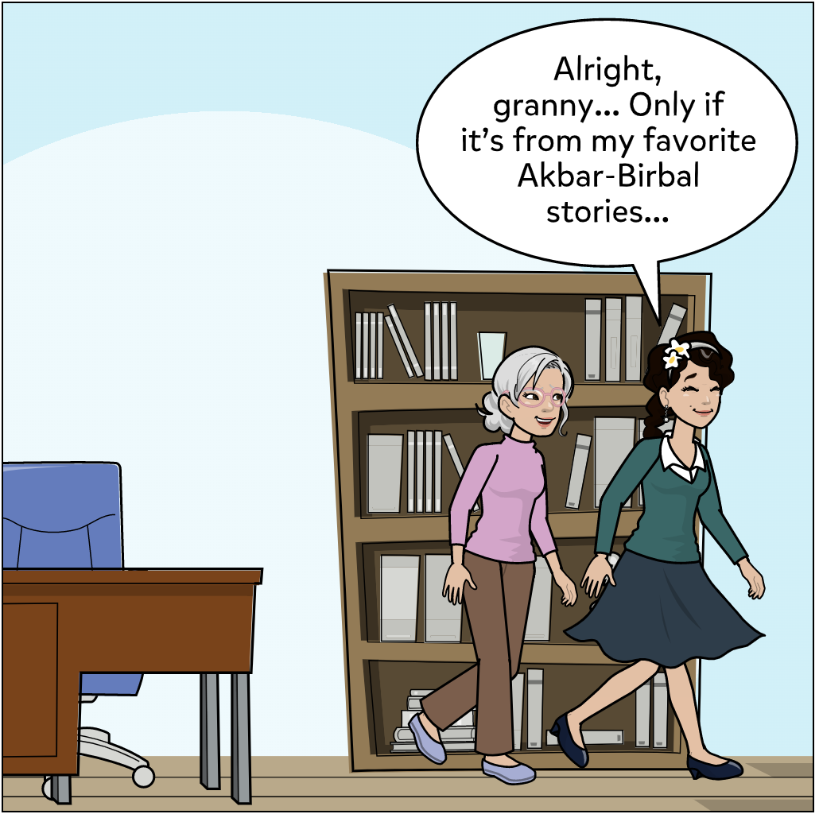

Slide 6
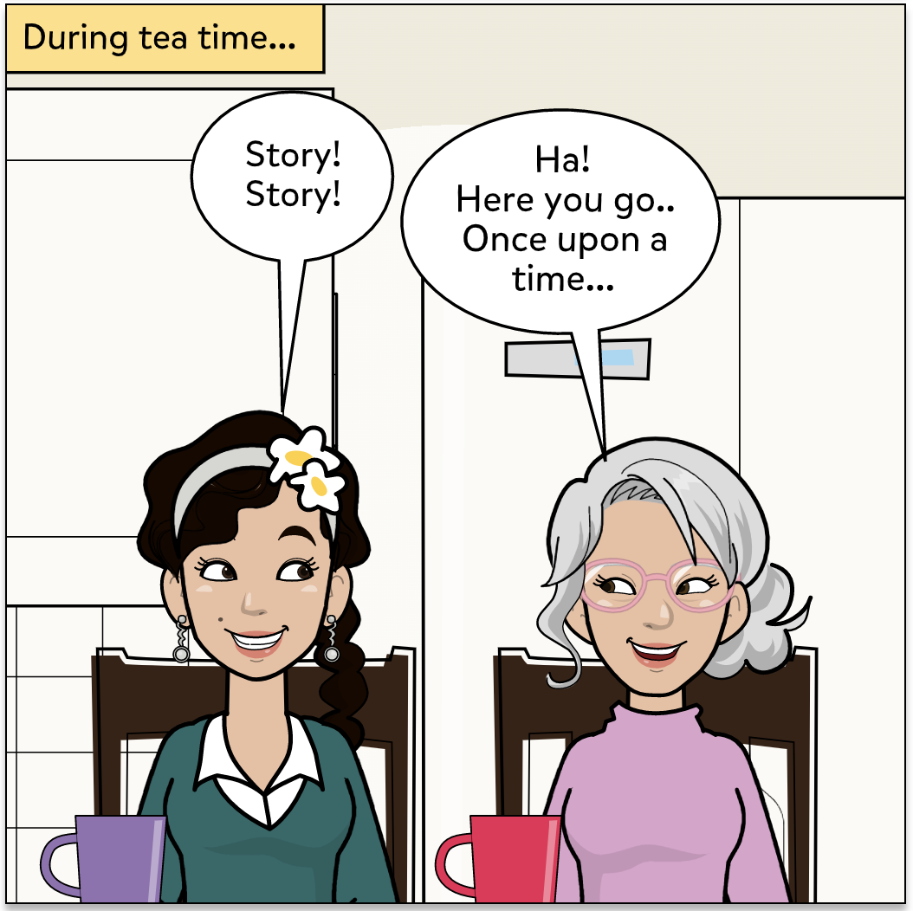

Slide 7
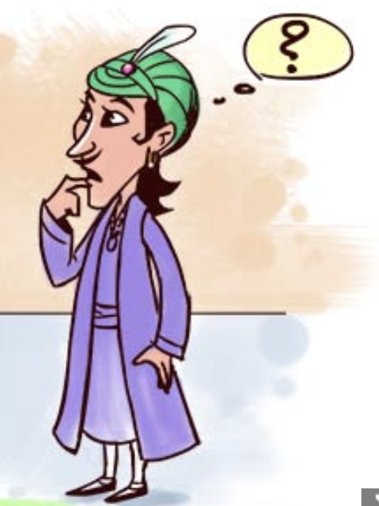
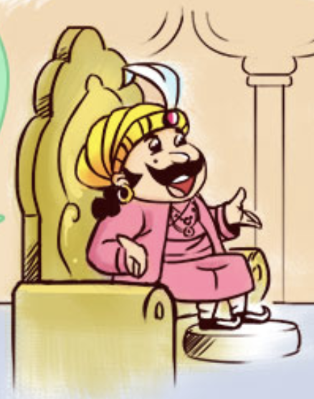
Once upon a time…
Birbal, In today’s party, I would like to serve guests with 100 different sweets. Make it ready by evening!

Slide 8


Birbal plans to consult his friend – who is head of chain of restaurants!

Slide 9

No problem, Birbal!
I have multiple restaurants across the city.
This is my manager.
He will help you to get best chefs and stoves required.

Slide 10
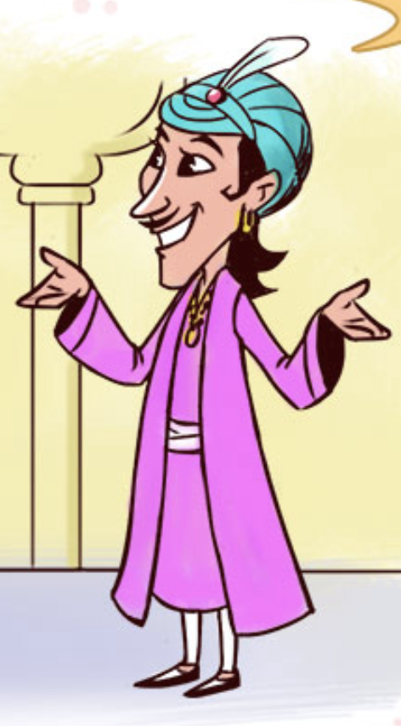
Birbal, Could you please specify number of chefs and stoves required?
Guess 4 chefs with 2 stoves each should work!
Sure! Here are the chef details. You must provide them with the recipes and raw materials.
I can do that! Thanks!

Slide 11



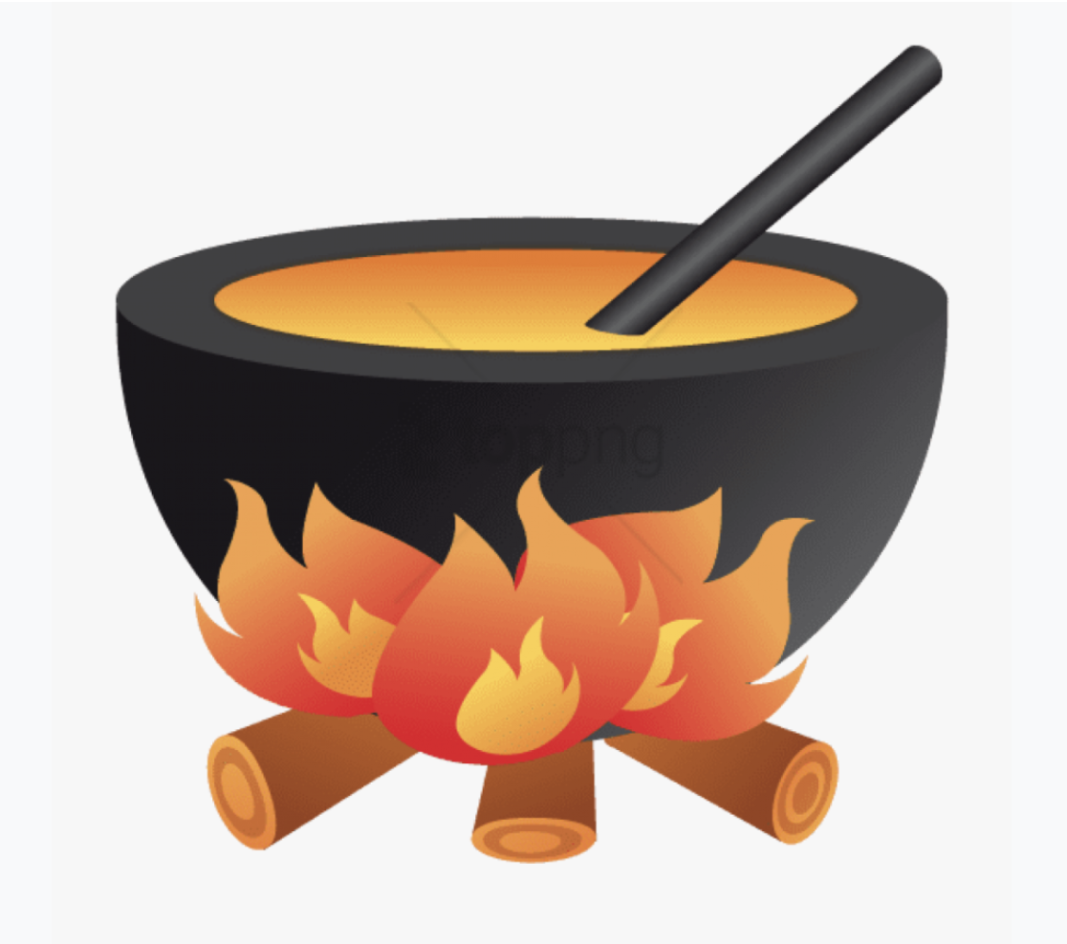
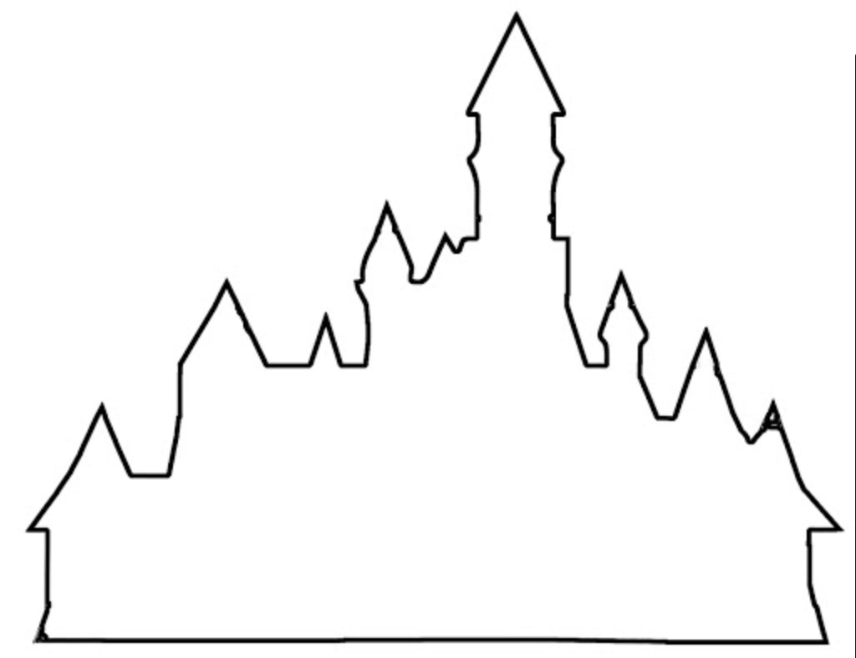
Birbal got 4 chefs from 3 different restaurants with 2 stoves per chef!

Slide 12
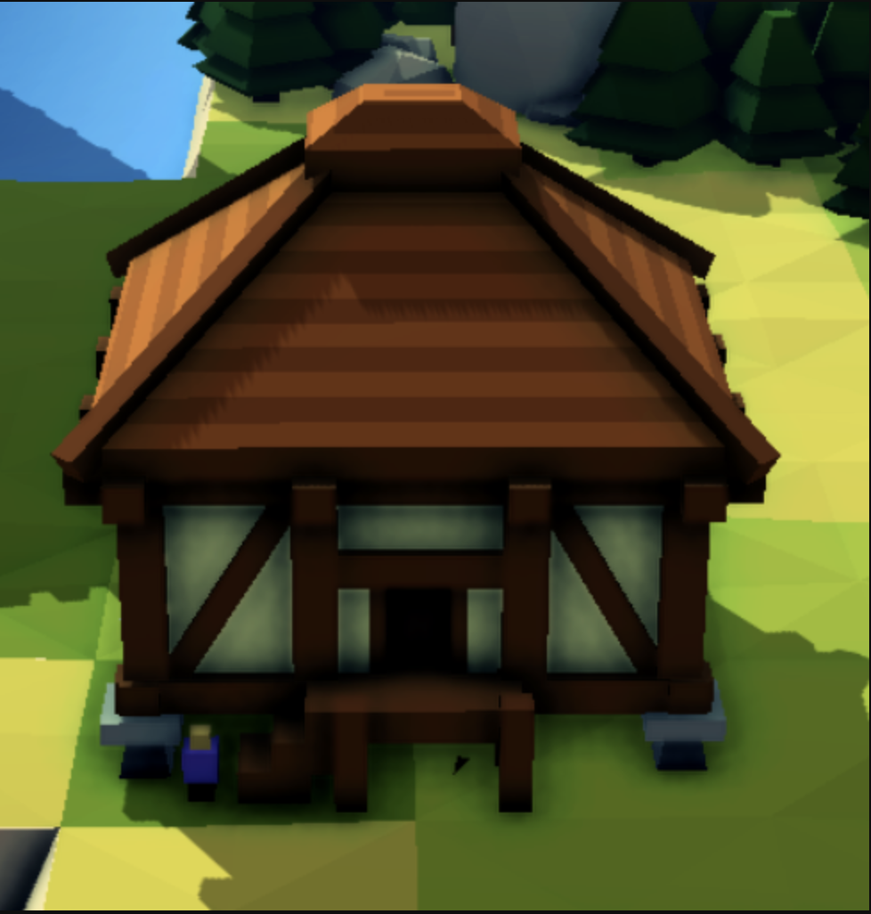


Birbal sent the location of the granary and recipe to each chef!

Slide 13
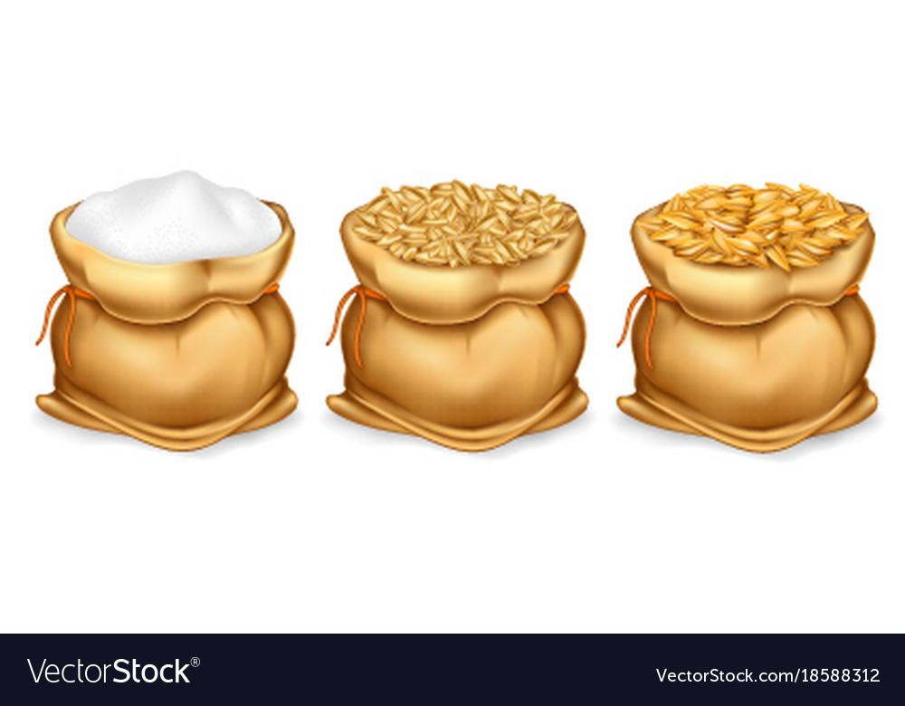
Each chef got their share of raw-materials!

Slide 14

Sweets were prepared!

Slide 15

Sorted and packed!

Slide 16

Sorted and packed!

Slide 17

Sorted and packed!

Slide 18

Sorted and packed!

Slide 19

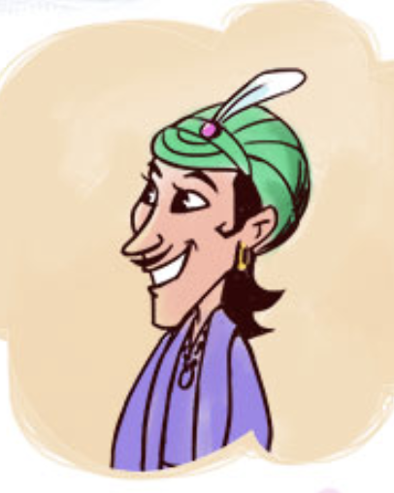
Sweet boxes delivered!

Slide 20
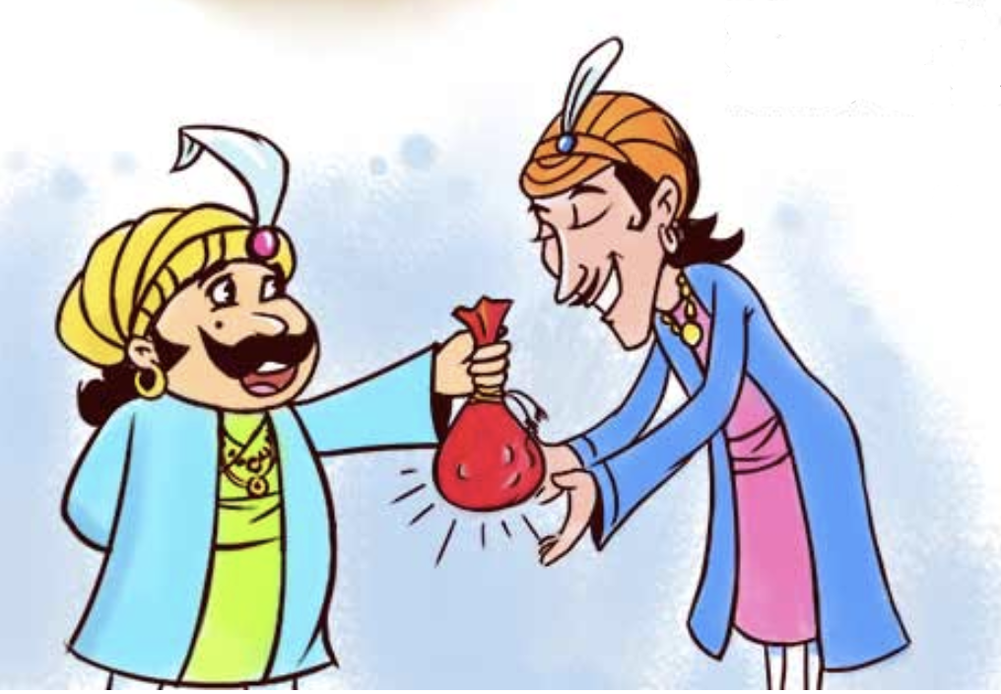
Akbar was very pleased with Birbal
Birbal, I am very happy with your service. Here you go!
Thank you, my lord!

Slide 21
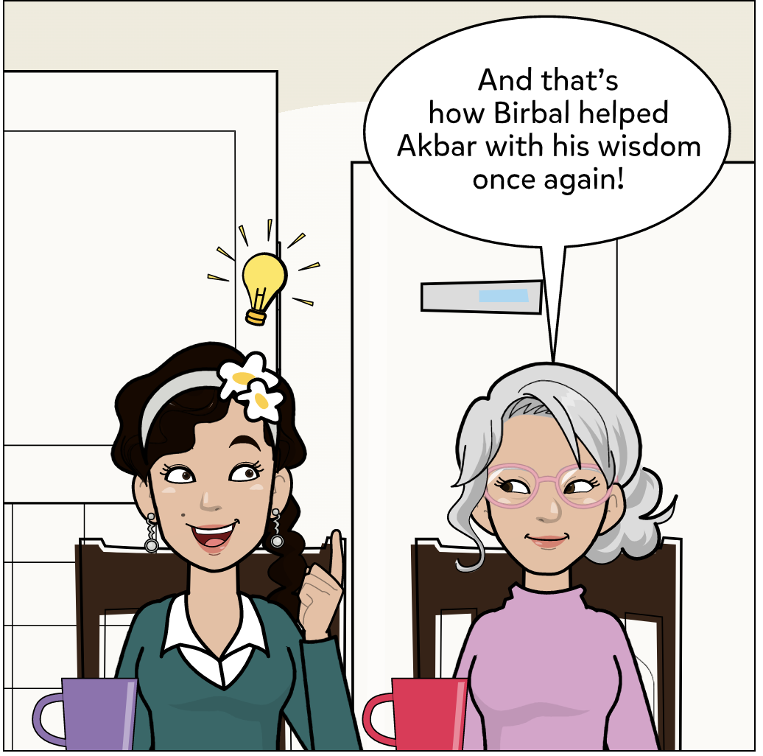

Slide 22
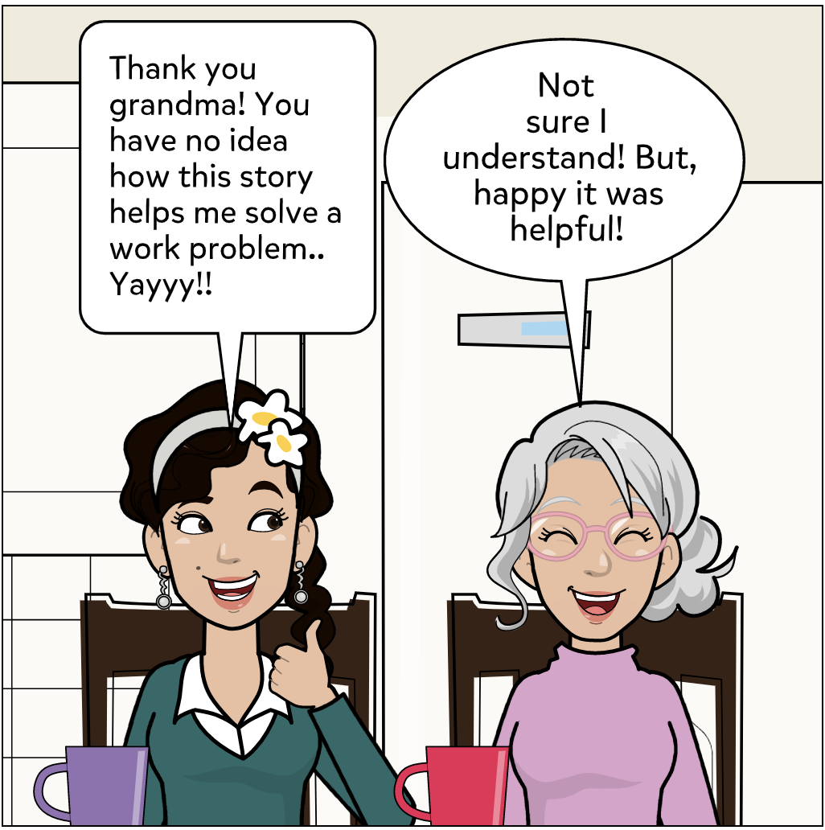

Slide 23
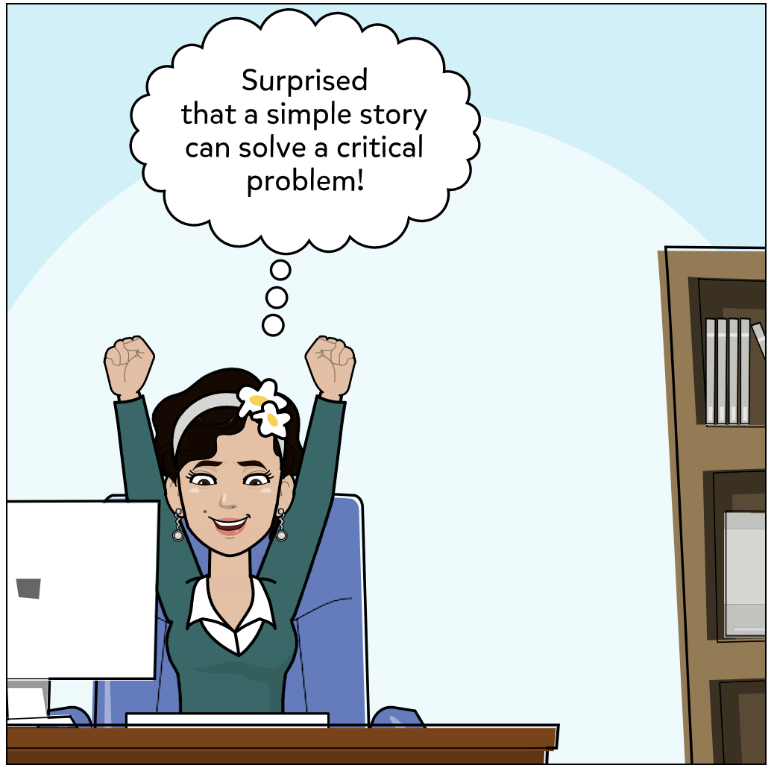

Slide 24
What did Jaya learn?
Let’s re-visit.. But now in technical jargons…

Slide 25
Developer has a job that cannot potentially run in a single machine
Job: 100 different sweets Time: By evening
Developer
Spark Driver

Slide 26
Spark Driver gets help from Cluster Manager
Cluster Manager
Spark Driver

Slide 27
Cluster Manager appoints Application Master to manage this job
Cluster Manager
Application Master

Slide 28
Spark Driver negotiates for resources with Application Master
Note: Application master is just a coordinator.
Resources are owned by Cluster Manager. He must request the resources from Cluster Manager only!
Application Master
Spark Driver
Resources required: 4 chefs with 2 stoves each

Slide 29
Restaurant: Physical worker; Cook: Executor; Stove: Cores !
Workers
Executors
Cores

Slide 30
Spark Driver sends the code and data location to every executor!
Data location
Code
Spark Driver
Executor

Slide 31
Each executor reads data from data-store!
Data

Slide 32
Tasks are executed in the cores of the executors
Executor
Data
Cores
Code
Stage outputs

Slide 33
Shuffle in progress

Slide 34
Shuffle in progress

Slide 35
Shuffle in progress

Slide 36
Shuffle in progress

Slide 37
Action (e.g. collect()) executed!

Slide 38
Job Completed!

Slide 39
Thank you!

